Slide 1
SMART BUY
~purchase your products at ease
Presentation by : Batch A -13 of Cse -1
Project guide : mrs. P. Sandhya
19L31A0518 – B. Siva Kumar
19L31A0512 – P. Vatsalya
19L31A0526 – V. Keerthi
20L35A0502 – Pavan Kalyan Mahanty

Slide 2
About The Project
Today’s audience prefers to be informed as it gives them the power of choice. And this is how the idea of developing a price comparison website took place. With price comparison engines, there are a variety of choices like the number of items on sale, choice or types of brands, diverse offers, and many more.
Online price comparison websites have made things simpler as we can shop online and even find suggestions, alternatives, and other new products in the same price range, making our online shopping a pleasurable experience.
Price comparison site aggregate information about product prices on different websites, display this information, and thus allow consumers to choose a store to buy from based on the price. This helps consumers to have better understanding about product quality ,its features and its price.
It can also earn revenues from click through when every time a potential customer opts to view a firm’s listing.
User can also review both the product and retail partner.
On the other side it’s a benefit for the businesses selling products and services. For them, price comparison sites are promotional platforms. Having an online store featured on a price comparison website increases the number of visitors and, consequently, buyers – if the prices are competitive enough, that is.

Slide 3
Features
Search Engine to search products for over websites.
(we included amazon and flipkart in our project)
Listings where comparisons are shown.
Latency from the point of clicking from search button to getting results is less than 5 seconds.
Geolocation to know user’s location and time to know when user is viewing
Page views to track number of viewers
Visit to site button ,provides direct redirection towards the clicked website.
Supports multi-word queries in Search bar.
Built on PHP Simple DOM web scraping platform.

Slide 4
Advantages
Easy search for cheap products
Saves money
Saves time
Online stores on single platform
Reviews of real customers
Collection of most popular products
More sales
Additional channel for customer interaction

Slide 5
Disadvantages
When price comparison site is used ,the price results may not match what the consumer asked for in a search or a trader may come up in the results that doesn’t cover the area consumer lives in.
When you use comparison sites, you won’t be getting a full picture of the market, and you could be missing out on an even better deal from a company that doesn’t subscribe.
When you go to a supplier direct, you’ll often be given a point of contact, someone you can go to if you have any queries, and who will ensure that your product is going to give you exactly what you want it to. This is not the case on a comparison site – you will be shown a list of potential products, and then you’re on your own. You need to make the decision without any additional help or advice, and this can lead to people picking a something that just isn’t what they need; they can be paying out for something that just isn’t going to help them if they need it to.

Slide 6

Technology Stack
Front End: HTML5,CSS3,Web Scrapping.
Framework: Bootstrap4,
PHP, Java Script.
Tools: Visual Studio, XAMPP

Slide 7
About the technology stack that we used:
Front end:
HTML5 is the latest and enhanced version of HTML. HTML5 is a standard for structuring and presenting content on the internet.
CSS is used to control the style of a web document in a simple,easy way. CSS3 is collaboration of CSS2 with its new specifications.
Framework:
Bootstrap 4 is a most popular front end framework in the recent time. It is sleek, intuitive, and powerful front-end framework for faster and easier web development.
PHP is acronym of Hypertext Preprocessor (PHP) is a programming language that allows web developers to create dynamic content that interacts with databases.
JavaScript is a lightweight, interpreted programming language with object-oriented capabilities that allows to build interactivity into static HTML pages.
Tools:
Microsoft Visual Studio is an integrated development environment (IDE) from Microsoft. It is used to develop computer programs, as well as websites, web apps, web services and mobile apps.
XAMPP is a free and open-source cross-platform web server solution stack package developed by Apache Friends, consisting mainly of the Apache HTTP Server, MariaDB database, and interpreters for scripts written in the PHP and Perl programming languages.

Slide 8
Web Scraping
Web scraping is the process of collecting structured web data in an automated fashion. It’s also called web data extraction. Some of the main use cases of web scraping include price monitoring, price intelligence, news monitoring, lead generation, and market research among many others.
Web scraping lets you collect data from web runners across the internet. It's also called web crawling or web data birth that constantly (or at least regularly) checks search engines or specific websites and collects their data. Crawlers can help you build an extensive database in a short amount of time and keep it up to date.
In general, web data extraction is used by people and businesses who want to make use of the vast amount of publicly available web data to make smarter decisions.
In our project, web scrapping is used for getting price information instead of using api to retrieve data.
This technology is used because of drawback with API’s – accessing speed , retrieval latency and its not free of cost.

Slide 9
What is web scraping used for?
Price intelligence is the biggest use case for web scraping. Extracting product and pricing information from e-commerce websites, then turning it into intelligence is an important part of modern e-commerce companies that want to make better pricing/marketing decisions based on data.
How web pricing data and price intelligence can be useful:
Dynamic pricing
Revenue optimization
Competitor monitoring
Product trend monitoring
Brand and MAP compliance

Slide 10
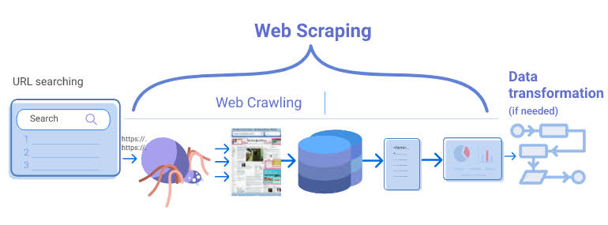
Working of the Project

Slide 11
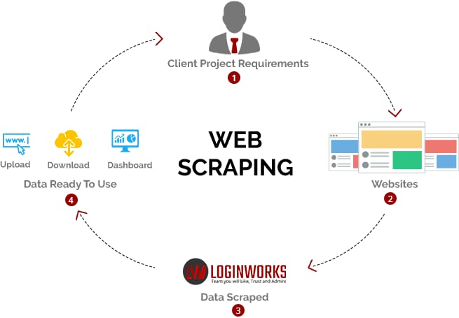

Slide 12
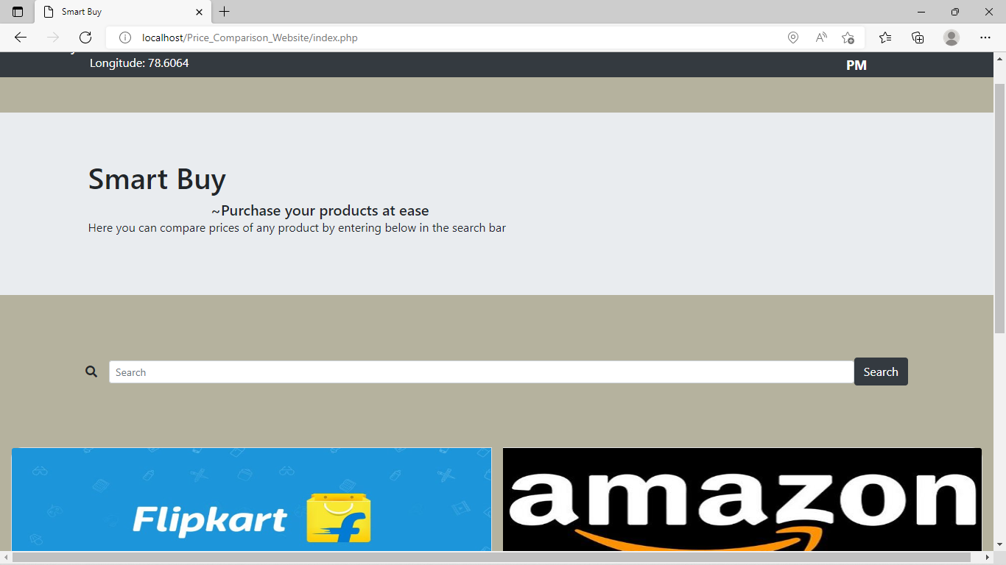

Slide 13
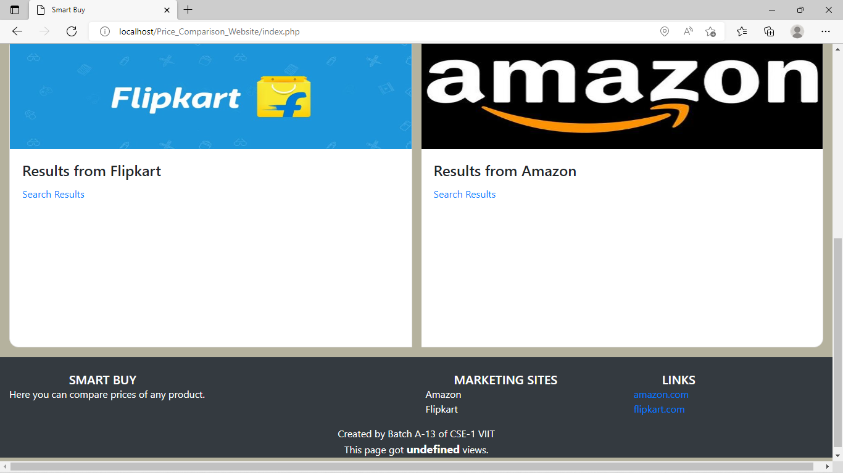

Slide 14
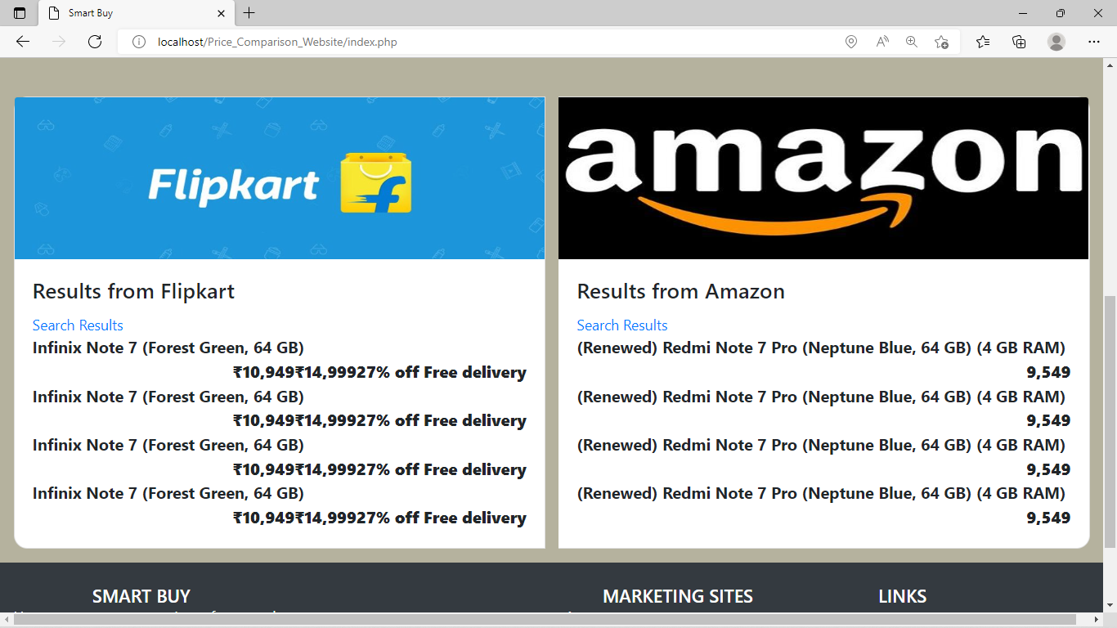

Slide 15
SMART BUY Project Guide : Mrs. P. Sandhya A Project by :Batch A-13
19L31A0518 – B. Siva Kumar
19L31A0512 – P. Vatsalya
19L31A0526 – V.Keerthi
20L35A0502 – Pavan Kalyan Mahanty

